Slide 1
Development of master curricula for natural disasters risk management in Western Balkan countries
UNIME project experience
Francesca Scribano
University of Messina
Logo of your organization
NatRisk project meeting/7-8 March 2018, Belgrade
Project number: 573806-EPP-1-2016-1-RS-EPPKA2-CBHE-JP
"This project has been funded with support from the European Commission. This publication reflects the views only of the author, and the Commission cannot be held responsible for any use which may be made of the information contained therein"

Slide 2
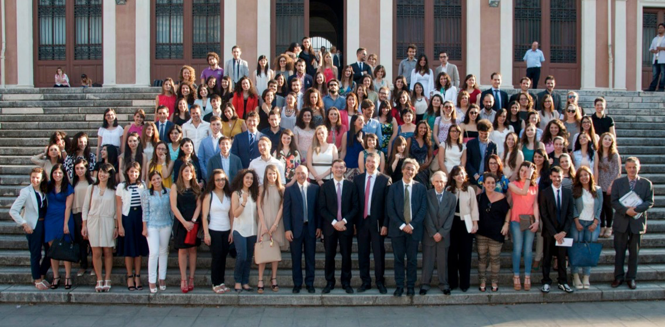
UNIME in brief
Development of master curricula for natural disasters risk management in Western Balkan countries
SINCE 1548
Students (a.a. 2015/16): 26,970, of which 6,279 freshmen
Professors: 1,223
Technical and Administrative Staff: 1,409
Graduates (a.a. 2015/16): 4,644
PhDs: 262
Departments: 12
Courses: 75
Ph.D. Courses: 12

Slide 3
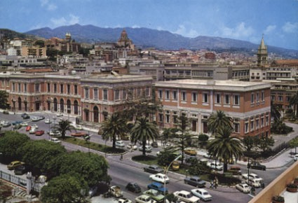
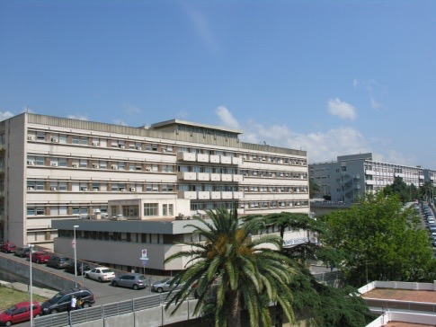
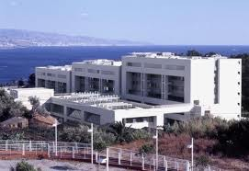
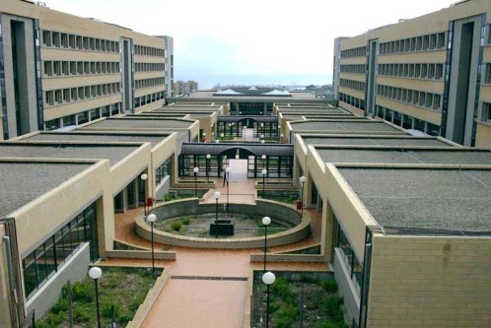
UNIME Main Campuses
Development of master curricula for natural disasters risk management in Western Balkan countries
The Central Building: Law, Economics, Politics, Education located in the city centre along with the Rectorate, the University’s Administration Offices and secretariats
The University Hospital, Policlinico Universitario “G. Martino”, hosting the Depts. of Medicine
The Papardo campus: Mathematics, Physics and Natural Sciences and Engineering
The Annunziata Campus: Veterinary Medicine, Pharmacy and Arts and Humanities

Slide 4
International Networks
Development of master curricula for natural disasters risk management in Western Balkan countries
Association of Universities from the countries of the Mediterranean basin. It counts 103 associated Universities coming from 24 countries of both shores of Mediterranean
Network supported by Aix-Marseille University, currently including 85 universities across 19 countries. It brings together the main universities of the Maghreb, Mashreq and Southern European countries
Network of Universities established with the purpose to create a permanent connection among Universities and Research centres from the Adriatic-Ionian Region
Organization of universities and national rectors’ conferences in 47 European countries. It plays a crucial role in the Bologna Process and in influencing EU policies on higher education, research and innovation

Slide 5
What is Erasmus+?
Development of master curricula for natural disasters risk management in Western Balkan countries
2007-2013
2014-2020
Tempus
Erasmus Mundus
Edulink
Alfa
1 Learning Mobility
Youth in
Action
2 Cooperation
Erasmus
Jean Monnet
Sport
Grundtvig
3 Policy support
Leonardo
Comenius

Slide 6
3 Main Key Actions
Development of master curricula for natural disasters risk management in Western Balkan countries
Key Action 1
MOBILITY OF INDIVIDUALS
Key Action 2
Transnational Strategic Partnerships
Knowledge Alliances & Sector Skills alliances
Key Action 3
SUPPORT FOR POLICY REFORM
Initiatives for policy innovation
Capacity-building projects
Erasmus Mundus Joint Master Degrees
EU and EXTRA EU mobility of learners and staff
COOPERATION FOR INNOVATION AND THE EXCHANGE OF GOOD PRACTICES
Support to European policy tools
Jean Monnet
Sport

Slide 7
Opportunities for HEIs from Partner Countries
Development of master curricula for natural disasters risk management in Western Balkan countries
Credit mobility (Key action 1)
Joint Master Degrees (Key Action 1)
Key Action 2:
Capacity Building for Higher Education
Strategic Partnerships
Knowledge Alliances

Slide 8
KA1 International Credit Mobility (ICM)
Development of master curricula for natural disasters risk management in Western Balkan countries
Short-term mobilities (no degree seeking students)
International outlook of Erasmus
STUDENT Mobility I, II and III cycle
STAFF Mobility for Teaching (STA)
STAFF Mobility for Training (STT)
1
2
3

Slide 9
ICM - How does it work?
Development of master curricula for natural disasters risk management in Western Balkan countries
Managed by Erasmus+ National Agencies in Programme Countries
HEIs set up inter-institutional agreements
IIAs set the framework for sending and hosting students and staff
3 – 12 months for students
2 to 12 months for traineeships (from 2018)
1 week – 2 months for staff
STA: min. 8 hours of teaching per week

Slide 10
ICM – How to Apply
Development of master curricula for natural disasters risk management in Western Balkan countries
ICM projects between Programme and Partner Countries are selected each year on a competitive base (deadline usually in February)
Only Programme Country HEIs can apply to their National Agency to manage mobility projects
Partner Country HEIs should strengthen their links with HEIs in Programme Countries to get involved

Slide 11
ICM – Proposal Structure
Development of master curricula for natural disasters risk management in Western Balkan countries
4 quality questions for each Project Proposal/Partner Country:
Relevance of the mobility project (30 pt): Internationalisation strategy; types of mobility
Quality of Cooperation (30 pt): Previous experience; definition of responsibilities and tasks
Quality of project design and implementation (20 pt): Phases of the mobility project, selection, support and recognition
Impact and dissemination (20 pt): Impact on different levels; dissemination measures

Slide 12
ICM – SOME EU DATA
Development of master curricula for natural disasters risk management in Western Balkan countries
Europe Italy
62,000 Financed Mobilities
50% Staff/50% Students
33,927
28,109
2015
2016
Budget: €11.6m €13.0m €14.0m
Requested: €40.4m €34.3m €39.8m
29% 38% 35%

Slide 13
KA2 - CBHE: objectives
Development of master curricula for natural disasters risk management in Western Balkan countries
Build capacity and help modernise higher education institutions in Partner Countries, to ensure a structural, long-lasting impact
Support modernisation & internationalisation
Improve quality
Improve the level of competences and skills
Enhance management, governance in HEIs
Promote people-to-people contacts, intercultural understanding
Voluntary convergence with EU HE policy developments

Slide 14
KA2 – CBHE in brief
Development of master curricula for natural disasters risk management in Western Balkan countries
Joint Projects: New curricula, joint degrees, learning and teaching methodologies, staff development, quality assurance, governance, Bologna tools…
Structural Projects: Reforms at national level with the support of the authorities in the Partner Countries (policy modernisation, Bologna policies, governance and management of higher education systems…)
Projects for Southern Mediterranean, Eastern Europe and Western Balkans countries may include an additional mobility component (cancelled from the 2018 call)
for students and staff, to and from Programme Countries and between Partner Countries
Similar rules as for credit mobility (max 12 months)

Slide 15
Ongoing European Projects
Development of master curricula for natural disasters risk management in Western Balkan countries
E+ ICM 2016-2017
E+ CBHE RESUME - Réseau Méditerranéen pour l’Employabilité
E+ CBHE EuNIT - European Project Design and Management in the South Mediterranean Region (Jordan, Lebanon and Libya)
E+ CBHE - NatRisk - Development of master curricula for natural disasters risk management in Western Balkan countries
E+ Strategic Partnership EU-MADE4LL – “European Multimodal an Digital Education for Language Learning”

Slide 16
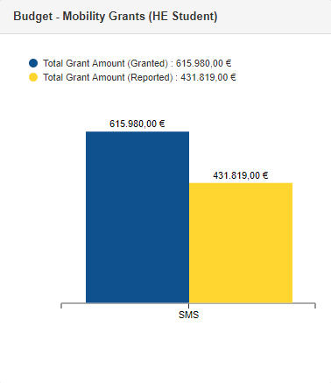
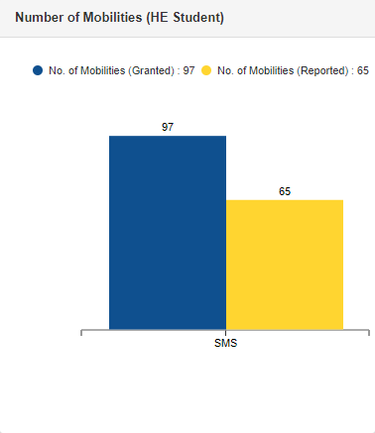
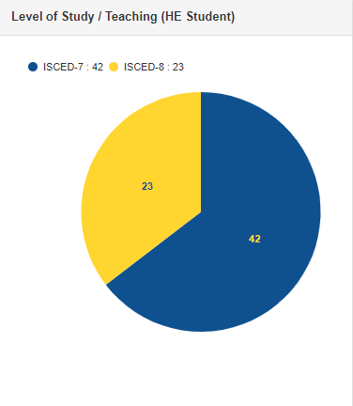
ICM – UNIME DATA
Development of master curricula for natural disasters risk management in Western Balkan countries
Call 2015 (06/15-07/17)
Granted
Budget: €615,980
# of mobilities: 97
Achieved
Budget: €431,819
# of mobilities: 65
70%
67%

Slide 17
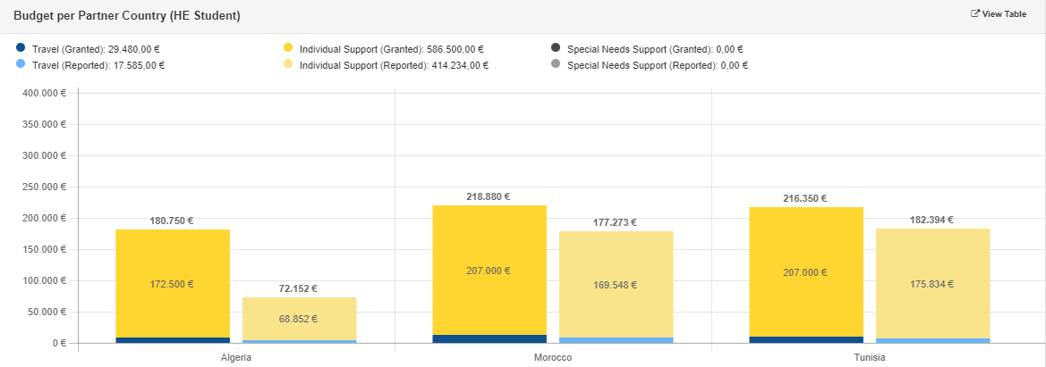
ICM – UNIME DATA
Development of master curricula for natural disasters risk management in Western Balkan countries
Call 2015
Partner countries: Morocco, Tunisia, Algeria

Slide 18
ICM – UNIME DATA
Development of master curricula for natural disasters risk management in Western Balkan countries
Call 2016 (06/16-07/18) Call 2017 (06/17-07/19)
Granted
Budget: €186,010
# of mobilities: 27 students, 2 staff
Partner Countries: Morocco, Tunisia
Achieved (02/2018)
Budget: €154,900
# of mobilities: - 27 students incoming - 1 student outgoing - 2 staff outgoing
Granted
Budget: €82,318
# of mobilities: 11 students, 7 staff
Partner Countries: Guatemala, Tunisia
Achieved (02/2018)
Budget: €42,594
# of mobilities: - 9 students incoming

Slide 19
ICM – UNIME DATA
Development of master curricula for natural disasters risk management in Western Balkan countries
Call 2018 (06/2018-07/2020)
Countries proposed: Morocco, Tunisia, Russia, Hong Kong, Vietnam, Argentina, Guatemala, Albania
Main issues:
- High competition - Definition of responsibilities and tasks
- Partner HEIs contributions

Slide 20
KA2 – CBHE Ongoing Projects
Development of master curricula for natural disasters risk management in Western Balkan countries
RESUME (RESeaU Méditerranéen pour l’Employabilité)
Objective: improvement and development of employability in the countries of the Mediterranean basin, including the promotion of entrepreneurship
Coordinator: UNIMED (Mediterranean Universities Union)
Partner Countries: Morocco, Tunisia, Lebanon
Programme Countries: Italy, France, Spain
Duration: 36 months (10/2015-10/2018)
Budget: €930.929
UNIME role: Work Package Leader, organized a 1-week training session in September 2017
www.resumeproject.eu

Slide 21
KA2 – CBHE Ongoing Projects
Development of master curricula for natural disasters risk management in Western Balkan countries
EuNIT (European Project Design and Management in the South Mediterranean Region)
Objective: Equip Partner Country HEIs with a team of personnel necessary to successfully run an “EU project design and management unit”
Coordinator: Aix Marseille – Tethys Consortium
Partner Countries: Jordan, Lybia, Lebanon (8 HEIs)
Programme Countries: Italy, France, Spain, Croatia
Duration: 36 months (10/2016-10/2019)
Budget: €1.000.000
UNIME role: organized a 1-week training session in October 2017; other training session in April 2018
www.eunitproject.eu

Slide 22
KA2 – CBHE Submitted Project
Development of master curricula for natural disasters risk management in Western Balkan countries
SToVi (Development of Sustainable Tourism Capabilities in Vietnam)
Objective: promoting the sustainable development of Vietnam in the field of higher education in order to enhance human resources in the tourism sector, with specific emphasis on new forms of tourism
Coordinator: UNIME
Partner Countries: Vietnam (4 HEIs)
Programme Countries: Italy, Poland, Spain
Involvement of HEIs and firms in the tourism sector
Duration: 36 months (01/2019- 01/2022)
Budget: ~ €1mln

Slide 23
Development of master curricula for natural disasters risk management in Western Balkan countries
THANKS FOR YOUR ATTENTION!
Francesca Scribano
Head of International Cooperation and Foreign Students Unit
International Relations Unit
University of Messina
fscribano@unime.it

